Slide 1



Slide 2
Pages
Home
All Products
Product Page
Login Page
Admin Page
Contact Us
About Us

Slide 3
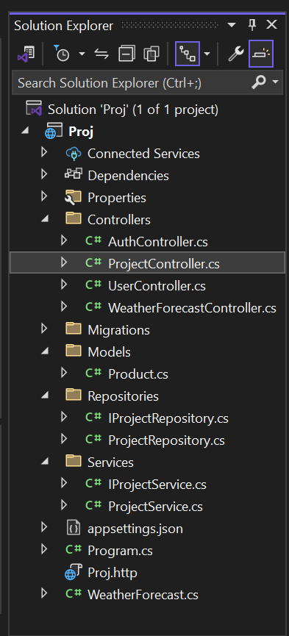
Project Directory

Slide 4
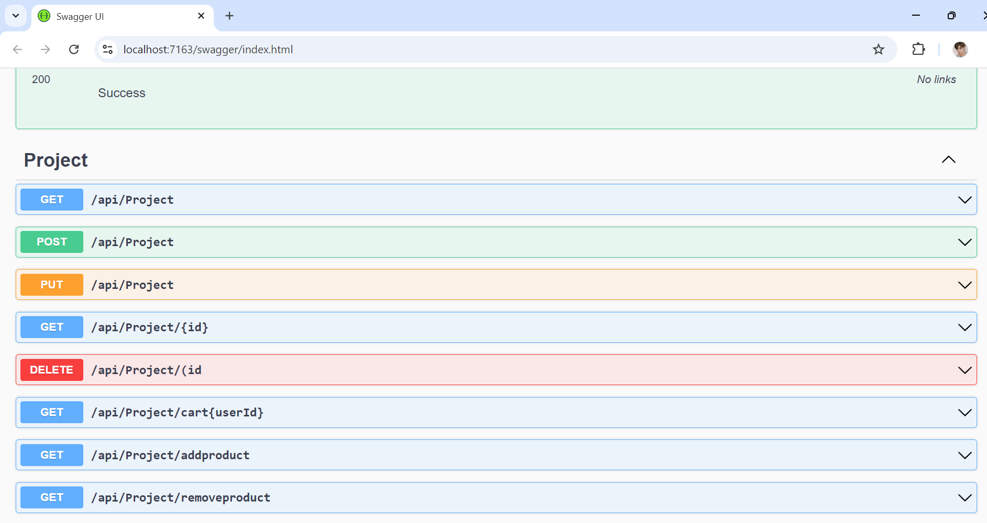
APIs

Slide 5
Tables in Database
Products (Category, Name, ImageLink, Description , OriginalPrice, FinalPrice, Discount, AmountSaved, Ratings)
Users (UserId, CartId, Username, Password, Email, FirstName, LastName)
Carts (id, CartId, ProductId, Quantity)

Slide 6

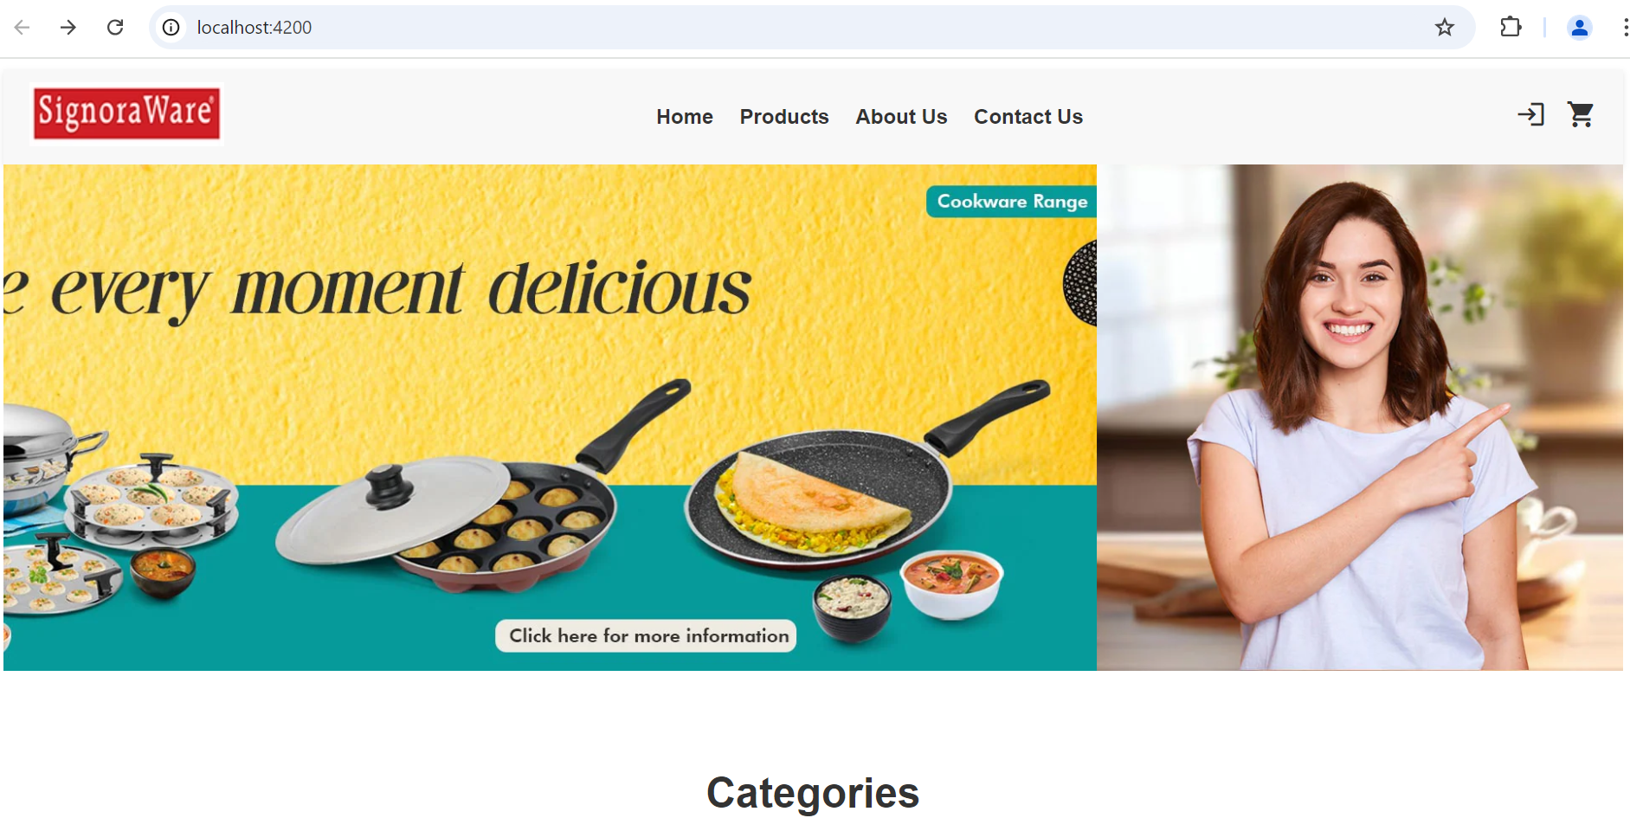

Slide 7
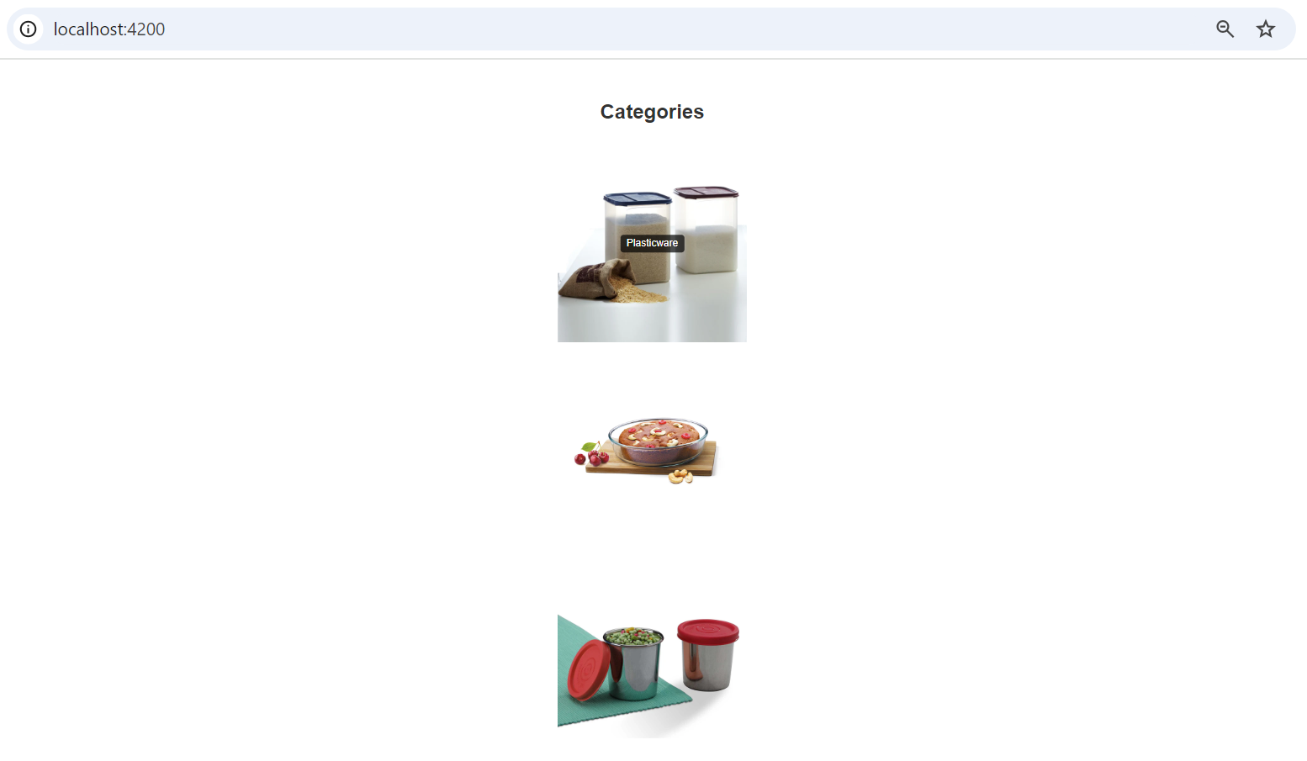
Overcoming nervousness
Confidence-building strategies

Slide 8
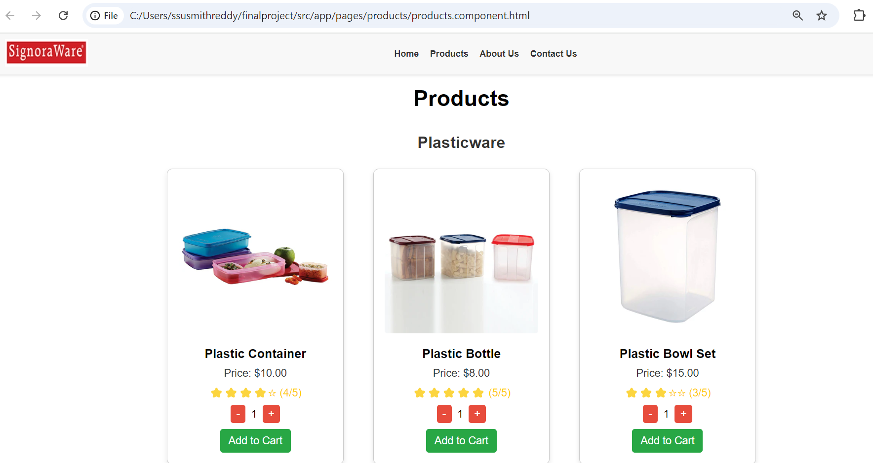
Overcoming nervousness
Confidence-building strategies

Slide 9
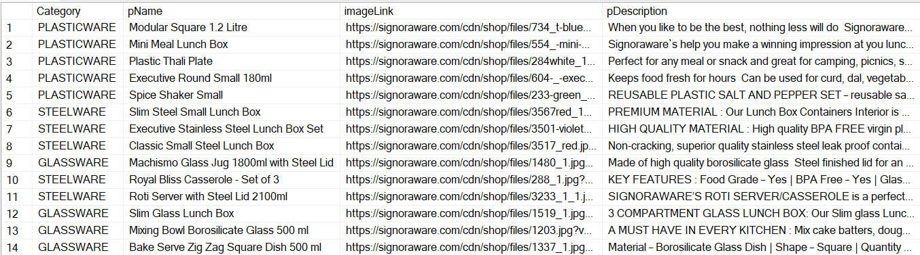

Slide 10
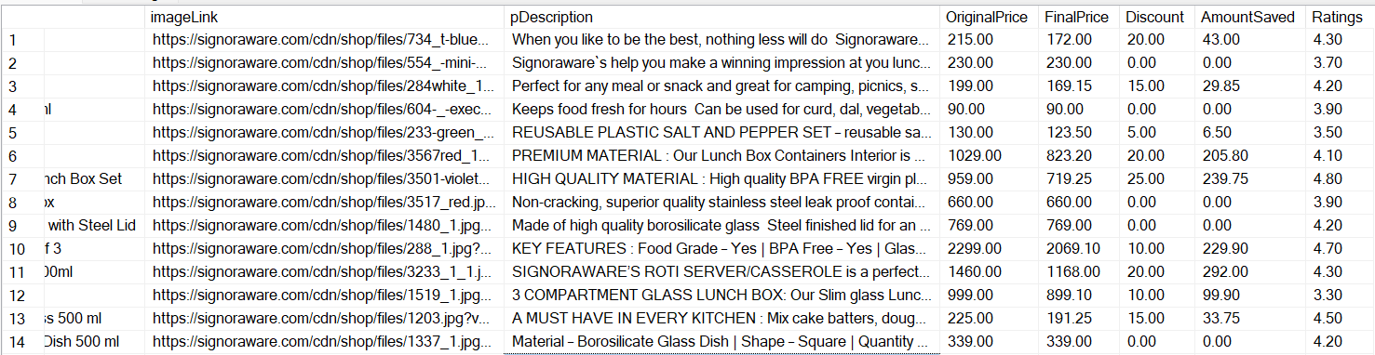

Slide 11
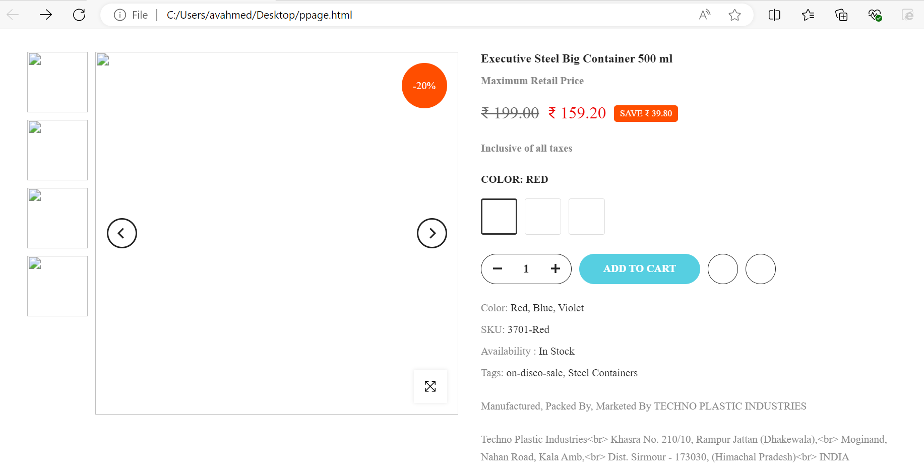
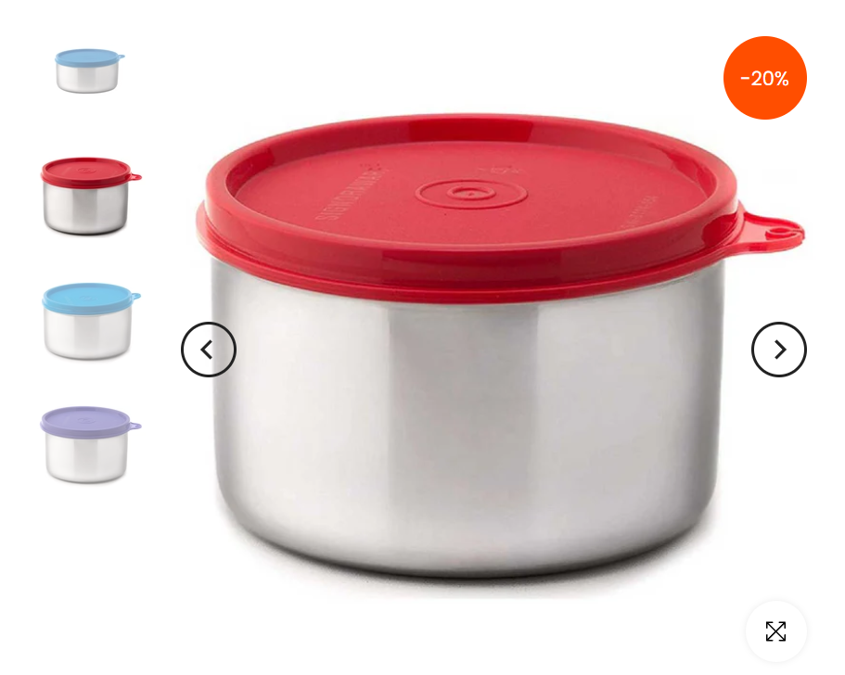
Overcoming nervousness
Confidence-building strategies

Slide 12
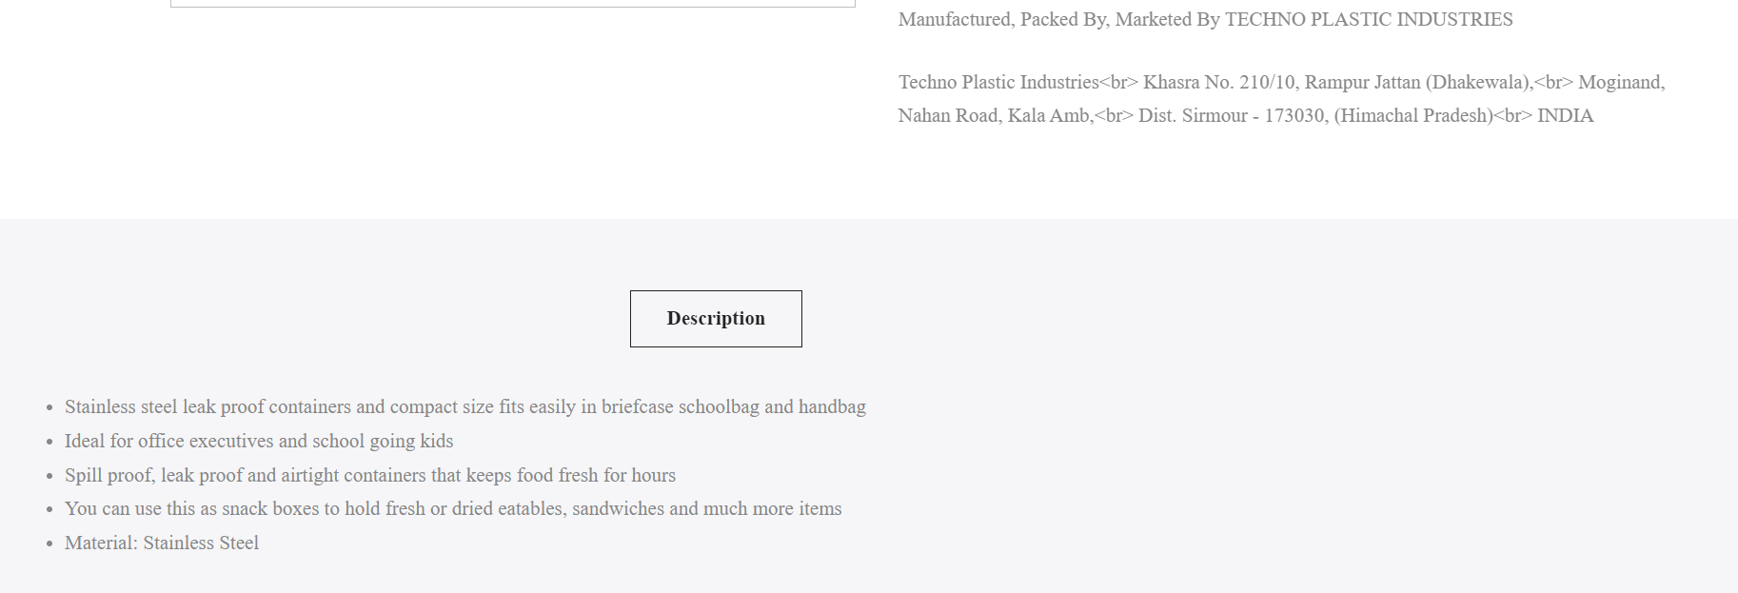
Overcoming nervousness
Confidence-building strategies

Slide 13
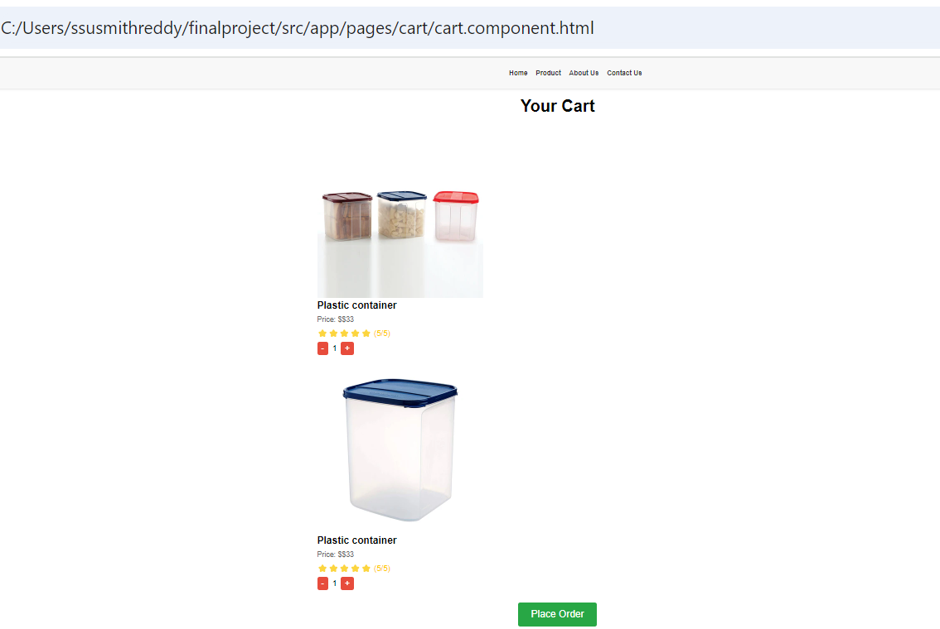
Overcoming nervousness
Confidence-building strategies

Slide 14
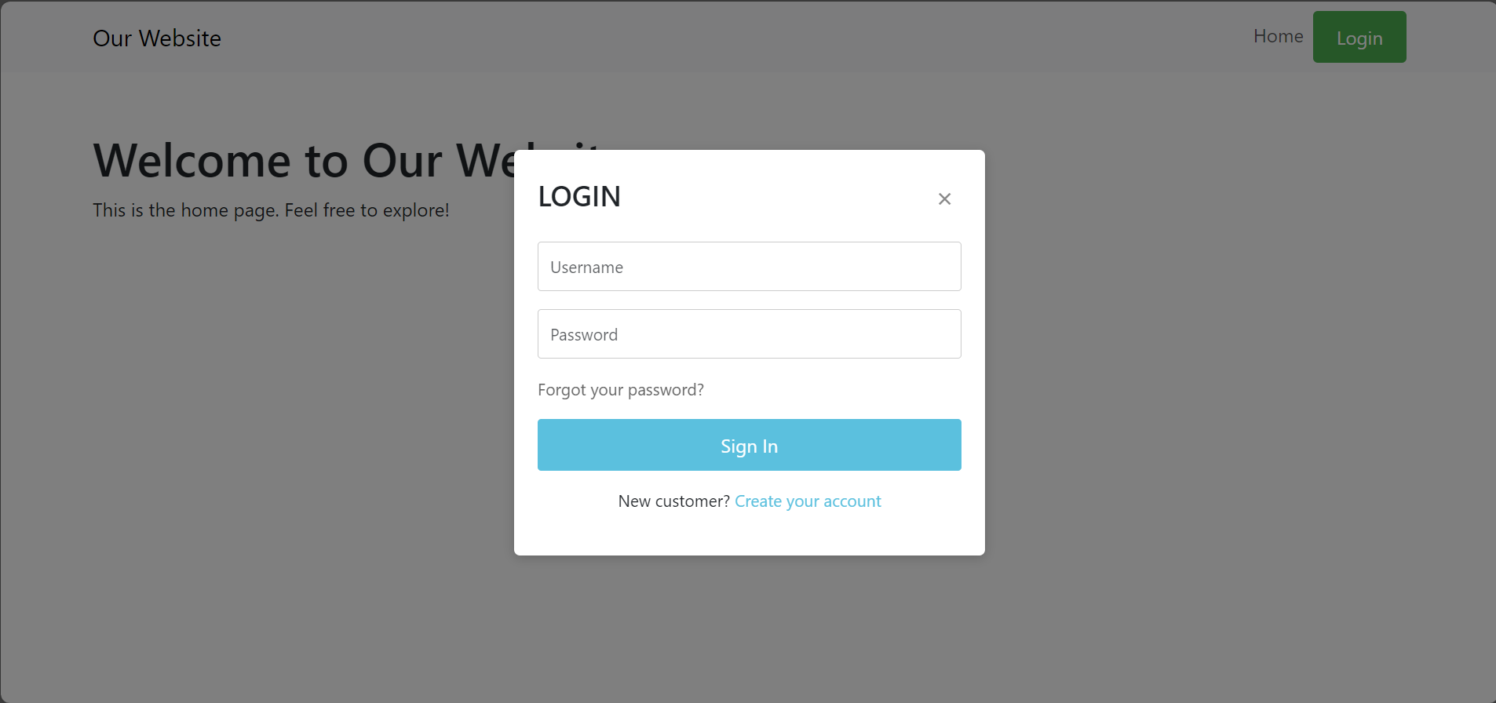
Overcoming nervousness
Confidence-building strategies

Slide 15
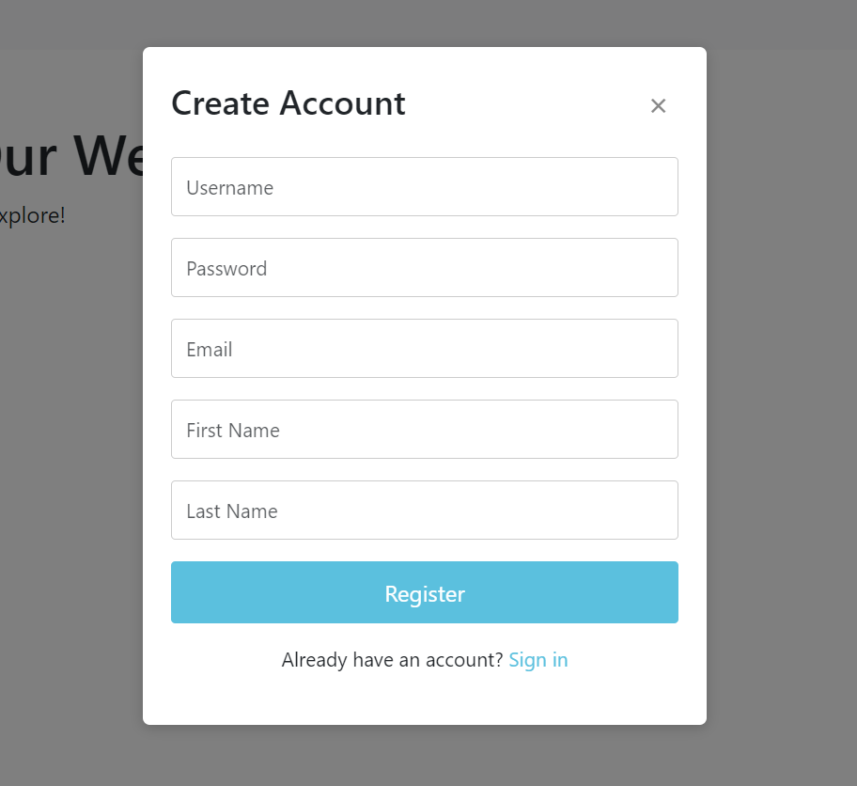

Slide 16
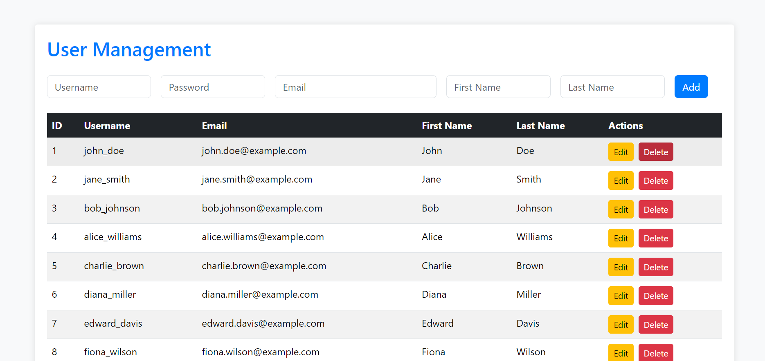
Overcoming nervousness
Confidence-building strategies

Slide 17
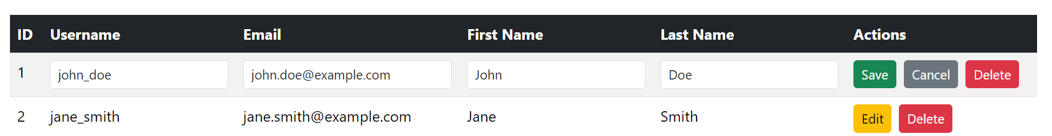
Overcoming nervousness
Confidence-building strategies

Slide 18
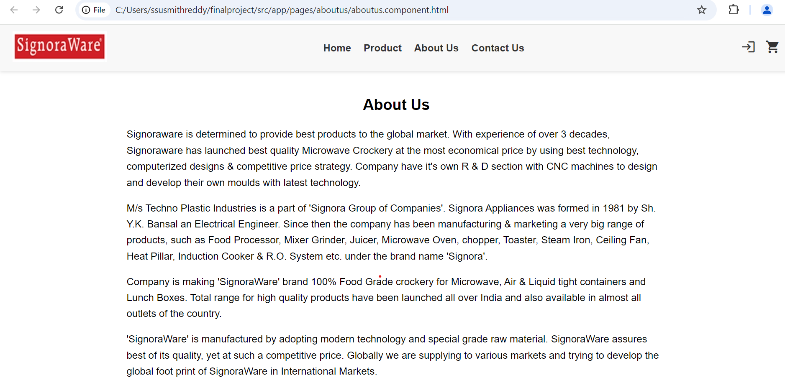
Overcoming nervousness
Confidence-building strategies

Slide 19
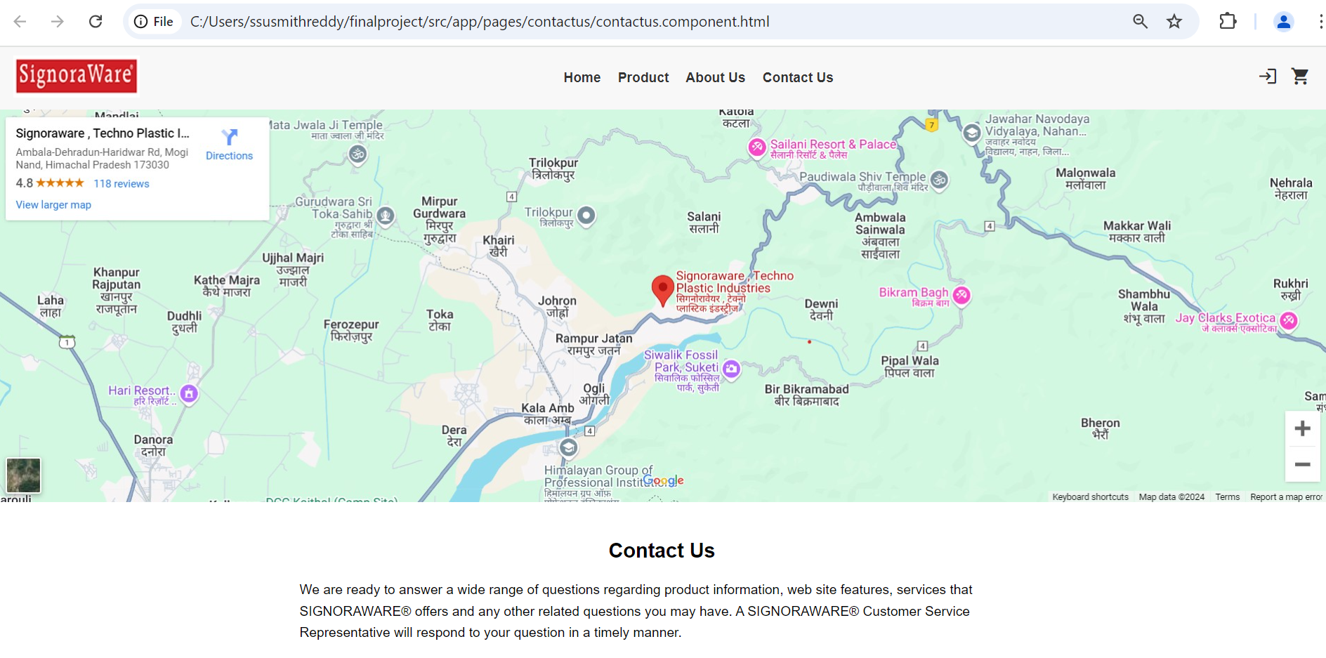
Overcoming nervousness
Confidence-building strategies

Slide 20
Thank You

